Slide 1
World Bank World Development Indicators API
Global Military Expenditure as Percent of General Government Expenses

Slide 2
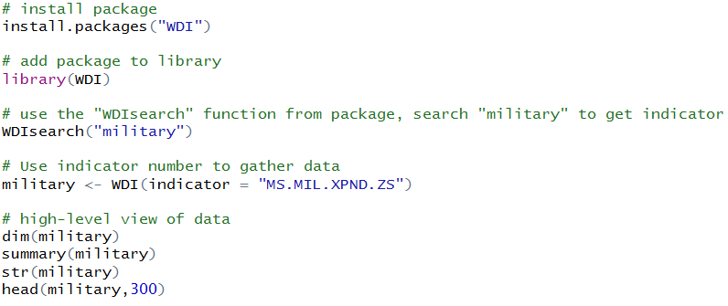
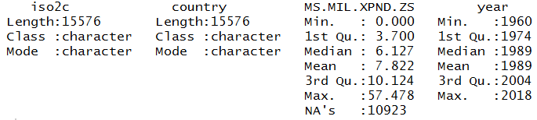
Data Gathered from World Development Indicators API
Pulled data from API using WDIsearch() function from WDI package, search for “military”
used indicator MS.MIL.XPND.ZS from search result
Military expenditure (% of general government expenditure)
Data Summary
length: 15,576 observations across four variables

Slide 3
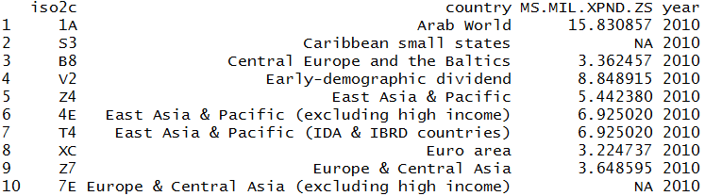
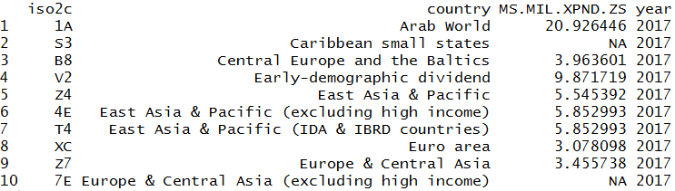
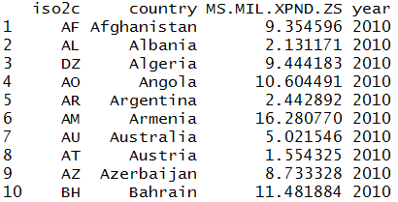
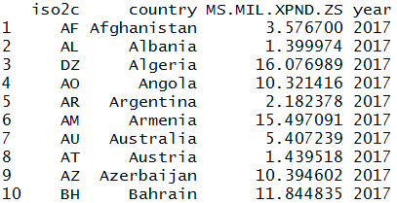
Data Preparation
created data frames for years 2010 and 2017 (head below):
Removed non-countries (the regions) and NA values from lists, reset row names (head below):

Slide 4
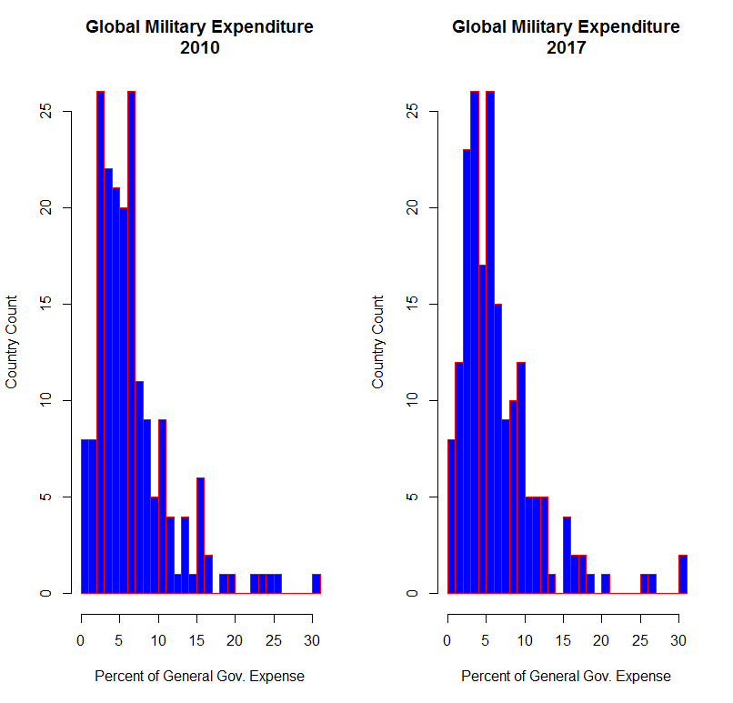
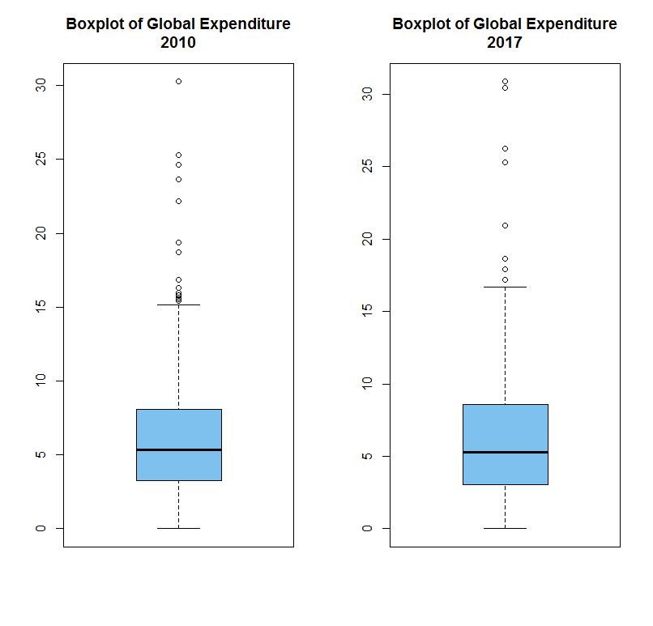
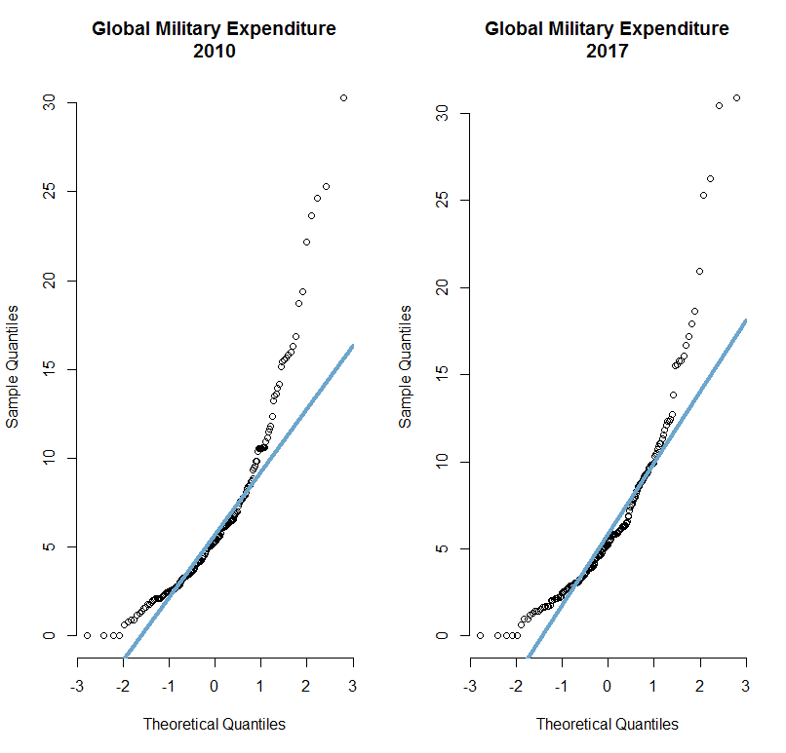
Performed Exploratory Data Analysis
After gathering data:
Boxplot
Histogram
QQ Plots

